Slide 1
Rich Controller Walker (RCW)
S. Maoz
J. O. Ringert
Computer Science Tel Aviv University
Slide 4
Topics in Software and Systems Modeling
Ido Salomon, Nir Zaidman,
Daniel Kuperman Azoulay, Sagi Aharoni
Supervisor: Prof. Shahar Maoz

Slide 2
Table of Contents
Ido Salomon
Nir Zaidman
Daniel K. Azoulay
Sagi Aharoni
Computer Science Tel Aviv University
Motivation
Goal
Overview
Choosing Variables (With Auto-Completion)
Enable/Disable Log Generation
Load and Walk on Log
Back-tracking on Walk
User-defined Predicates as Break-points and Watches
Reachability and Walk to User-defined Predicate
Persistence
Validation and Evaluation

Slide 3
Motivation
Ido Salomon
Nir Zaidman
Daniel K. Azoulay
Sagi Aharoni
Computer Science Tel Aviv University
Engineers need a tool to explore the Symbolic Controller produced by the synthesizer.
The currently implemented Controller Walker lacks functionality and is of limited use.
This demands development of a Rich Controller Walker (RCW) that supports the basic functions of the Controller Walker as well as advanced features (e.g logging, back-tracking and real-time predicate evaluation).

Slide 4
Goal
Ido Salomon
Nir Zaidman
Daniel K. Azoulay
Sagi Aharoni
Computer Science Tel Aviv University
Design and implement a rich and useful rich symbolic controller walker, which includes the following functions:
Choose variables to set with auto-completion.
Enable/Disable log generation.
Load and walk on log.
Back-tracking on walk to explore alternatives.
User-defined predicates as break points and watches.
Reachability and walk to user-defined predicate.

Slide 5
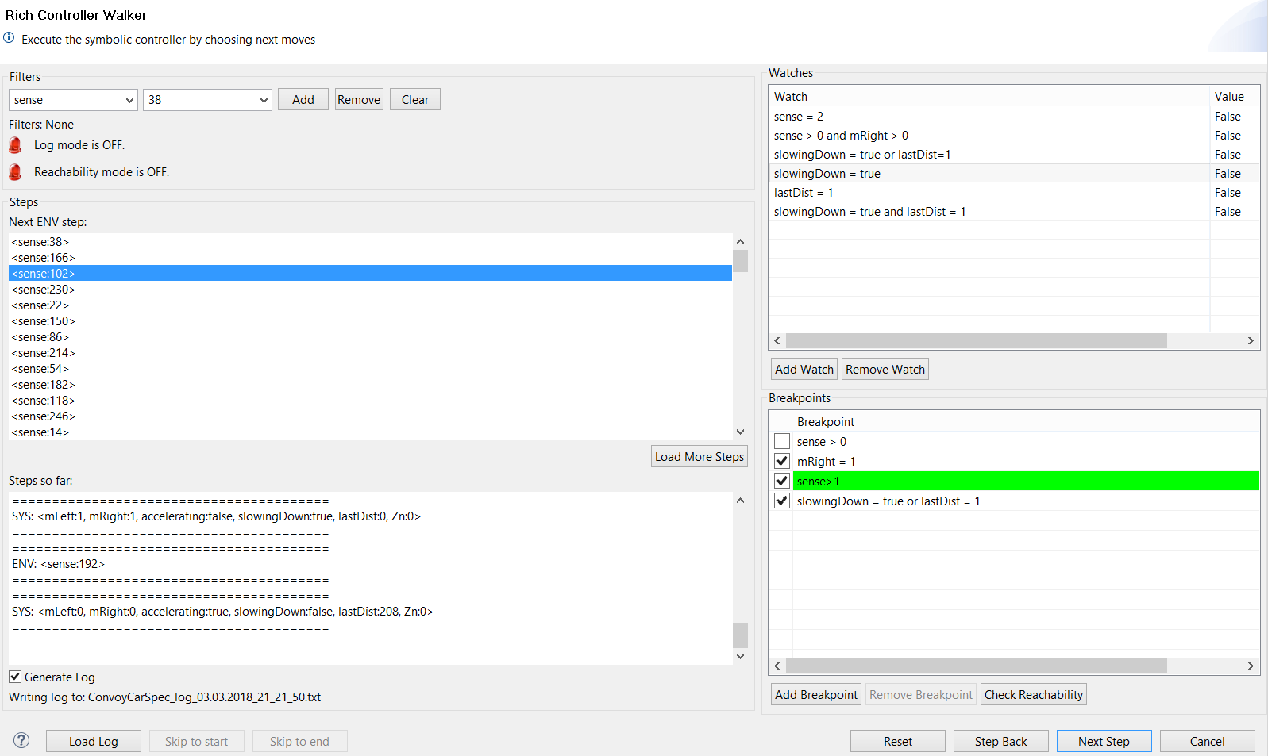
Overview (GUI)
Ido Salomon
Nir Zaidman
Daniel K. Azoulay
Sagi Aharoni
Computer Science Tel Aviv University
Choose var w/auto-complete
Add/remove/clear variable filters
List of active filters
Log/Reachability walk indicators
Watch predicate
Watch value
Possible next steps/
Current state (log/reachability)
Add/remove watch
Load more steps if they exceed the user-defined alt. step count
Steps/states traversed
Break-point predicate
Break-point enable/disable
Checks reachability to break-point/Exits reachability mode
Log generation enable/disable
Generated log’s name
Skips to end of log/route
Add/remove break-point
Loads log/Exits Log Walk
Skips to start of loaded log
Reset walk
Next/previous step/state

Slide 6
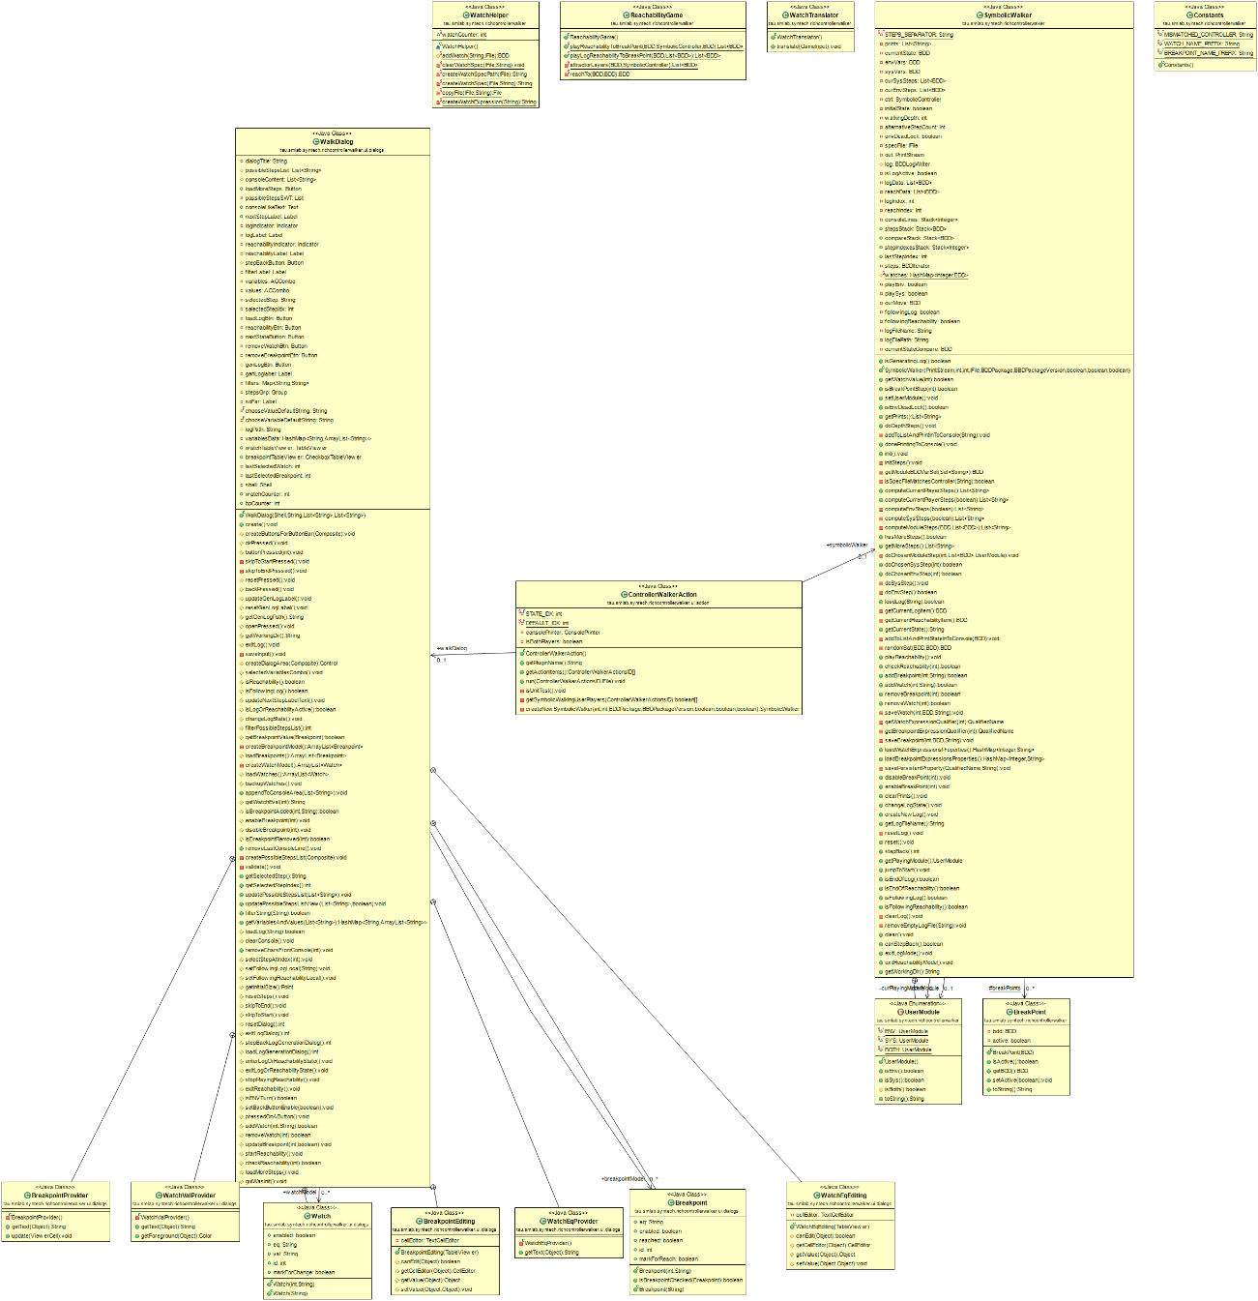
Overview (UML)
Ido Salomon
Nir Zaidman
Daniel K. Azoulay
Sagi Aharoni
Computer Science Tel Aviv University

Slide 7
Choosing Variables to Set (with Auto-Completion)
Ido Salomon
Nir Zaidman
Daniel K. Azoulay
Sagi Aharoni
Computer Science Tel Aviv University
Engineers can choose any variable available in the SPECTRA specification file, and set a value constraint.
The possible steps list is immediately filtered to display only the relevant steps.
It is possible to add more than one constraint to the filter. These are aggregated accordingly.
Constraints can be removed/cleared from filter at will.
Number of such constraints is unlimited.

Slide 8
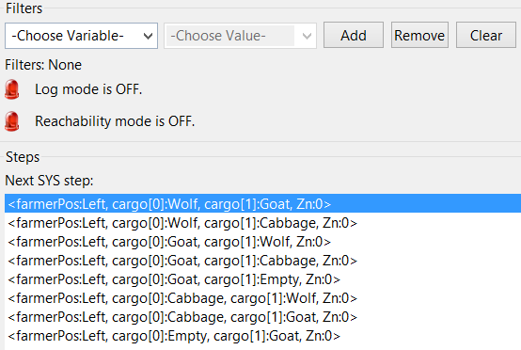
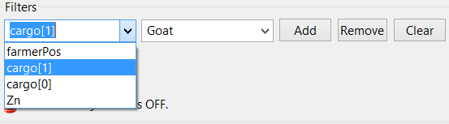
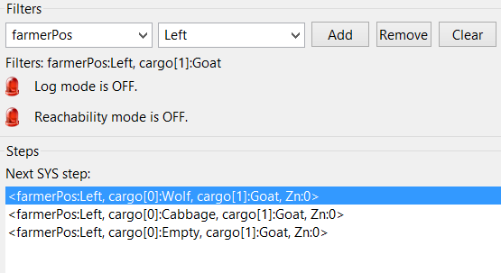
Example: Choosing Variables to Set (with Auto-Completion)
Ido Salomon
Nir Zaidman
Daniel K. Azoulay
Sagi Aharoni
Computer Science Tel Aviv University
Full step list
2 Filters
Filtered step list

Slide 9
Enable/Disable Log Generation
Ido Salomon
Nir Zaidman
Daniel K. Azoulay
Sagi Aharoni
Computer Science Tel Aviv University
Engineers can toggle log generation at any time via check-box in RCW. Log format is fully backwards compatible.
Generated log’s filename is displayed below check-box.
The log saves states. As such, stopping log before both players completed their turn may result in loss of final step.
New log created when user back-tracks (incl. skip to start in ‘Log Walk’) or loads log (enters ‘Log Walk’). Log cleared upon ‘Reset’.
The user is prompted before committing any action that affects the log or log generation.
Log files are saved to the specification file’s directory.
Log file name is of the format specName_log_date.txt.

Slide 10


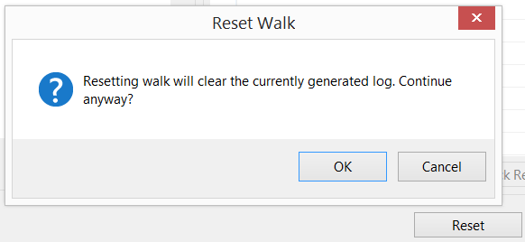
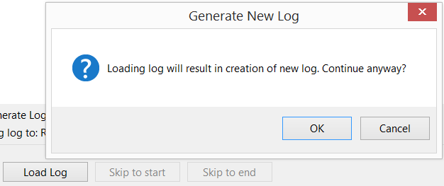
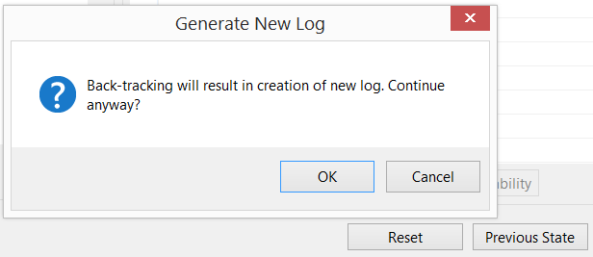
Example: Enable/Disable Log Generation
Ido Salomon
Nir Zaidman
Daniel K. Azoulay
Sagi Aharoni
Computer Science Tel Aviv University
Toggle
Examples of user prompts on log generation events

Slide 11
Load and Walk on Log
Ido Salomon
Nir Zaidman
Daniel K. Azoulay
Sagi Aharoni
Computer Science Tel Aviv University
Engineers can load previously generated log files at any time via a designated button in RCW.
Loading a log will clear previous walk’s state, but preserve watches and breakpoints.
While in ‘Log Walk’ mode, users will traverse the logged states until reaching end of log or actively pushing a button.
Upon exiting the mode, the users will be presented with all possible steps from the current state.
Users can skip to end or beginning of log via designated buttons.
‘Log Walk’ mode is indicated by a red/green indicator (green – on; red – off), which includes the loaded log’s name (if relevant).

Slide 12
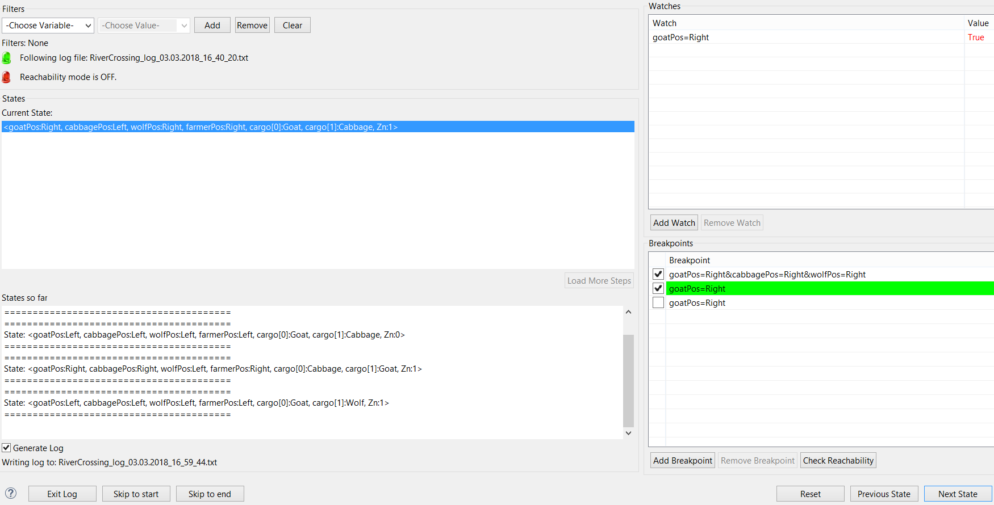
Example: Load and Walk on Log (Load)
Ido Salomon
Nir Zaidman
Daniel K. Azoulay
Sagi Aharoni
Computer Science Tel Aviv University
Indicator ON
Presents current loaded log state
Traversed logged states
Checks reachability with loaded states
Skips to first state in loaded log
Skips to last state in loaded log
Exits log

Slide 13
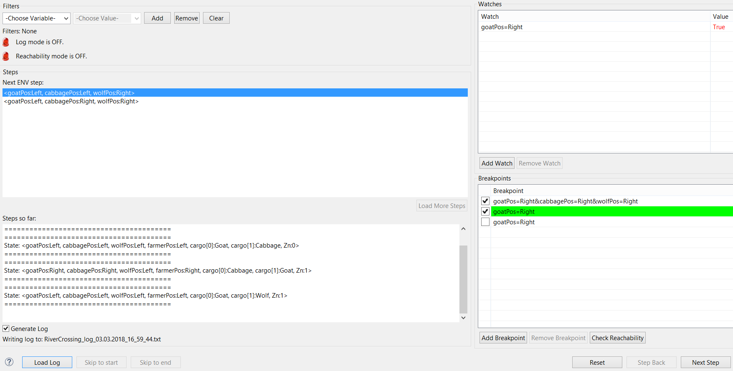
Example: Load and Walk on Log (Exit Walk)
Ido Salomon
Nir Zaidman
Daniel K. Azoulay
Sagi Aharoni
Computer Science Tel Aviv University
Indicator OFF
Now presents possible steps from state
Traversed logged states unchanged
Checks reachability in free walk
Can’t skip
Ready to load new log

Slide 14
Back-tracking on Walk
Ido Salomon
Nir Zaidman
Daniel K. Azoulay
Sagi Aharoni
Computer Science Tel Aviv University
Engineers can back-track their steps in all walk modes -
In ‘free’ walk, user steps back to return to previous step.
In ‘Log Walk’ and ‘Reachability Walk’, user goes to previous state.
User can’t back-track immediately after resetting the walk, loading a log/reachability game or exiting log mode.

Slide 15
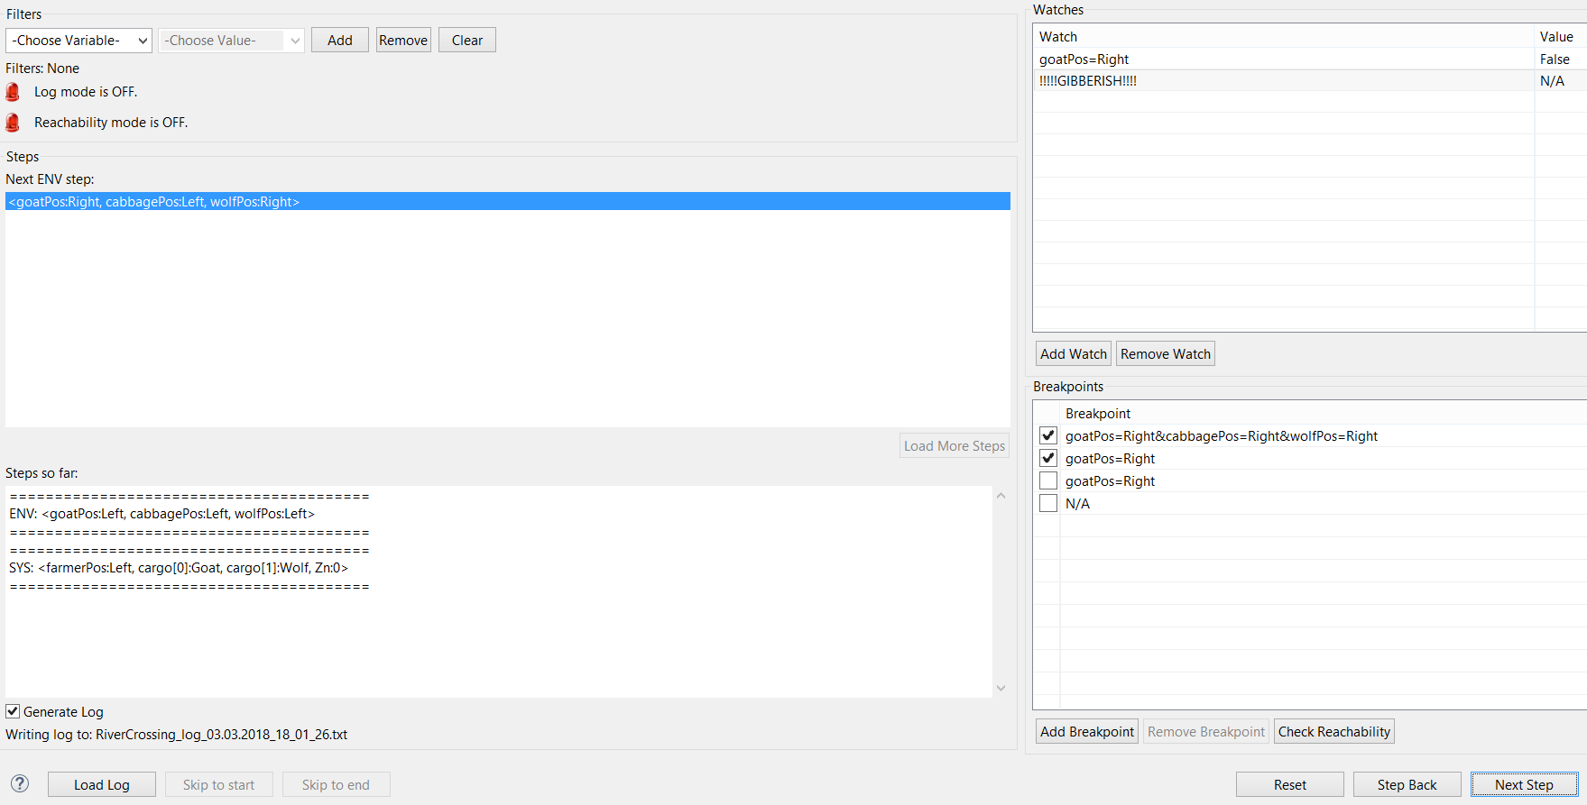
Example: Back-tracking on Walk (Original)
Ido Salomon
Nir Zaidman
Daniel K. Azoulay
Sagi Aharoni
Computer Science Tel Aviv University
Value is black as it is unchanged from previous step

Slide 16
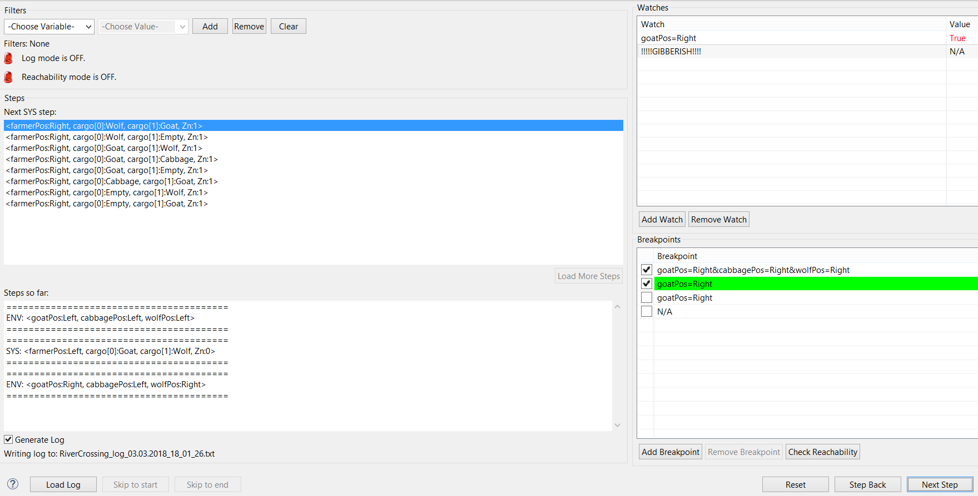
Example: Back-tracking on Walk (Next)
Ido Salomon
Nir Zaidman
Daniel K. Azoulay
Sagi Aharoni
Computer Science Tel Aviv University
Value is red as it changed from previous step

Slide 17
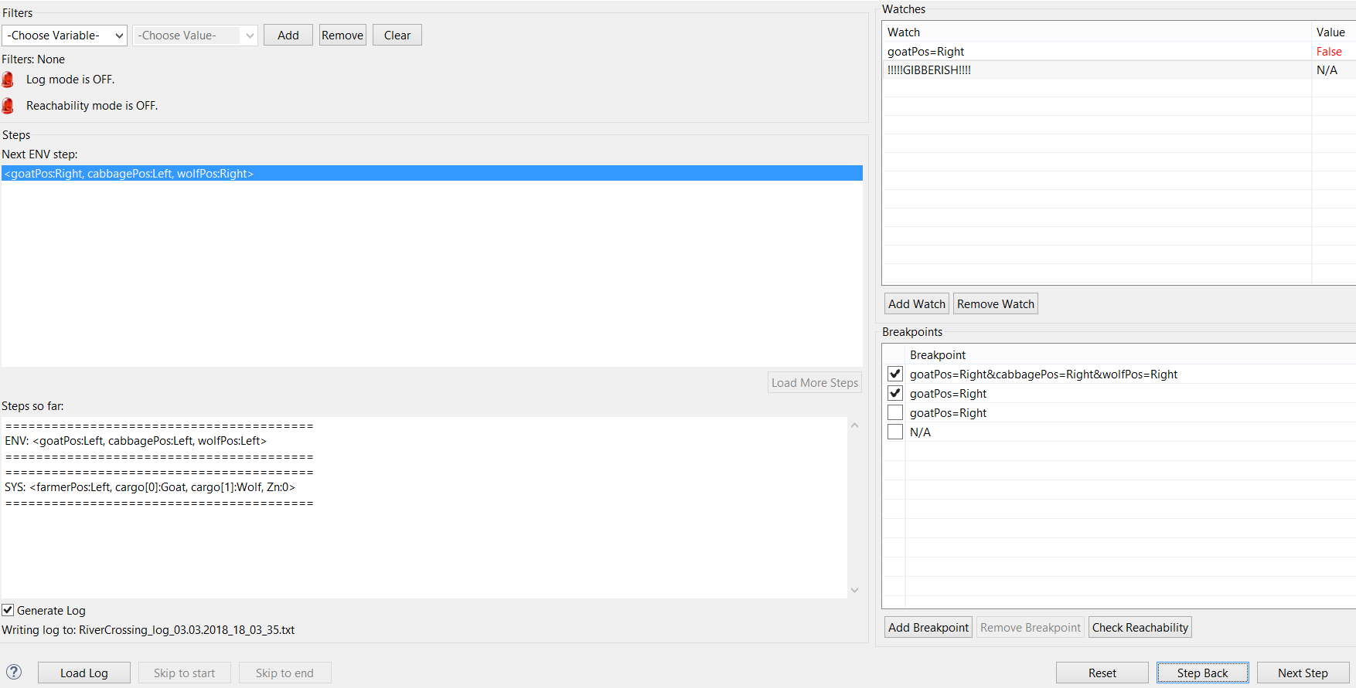
Example: Back-tracking on Walk (Back)
Ido Salomon
Nir Zaidman
Daniel K. Azoulay
Sagi Aharoni
Computer Science Tel Aviv University
Value is red as it changed from previous step
Identical to Original state, except for the status of the watch’s value, which shows that it now changed from the last visited state

Slide 18
User-defined Predicates as Break-points and Watches
Ido Salomon
Nir Zaidman
Daniel K. Azoulay
Sagi Aharoni
Computer Science Tel Aviv University
Engineers can add and remove predicate expressions to be treated
as watches/break-points.
We generate watches/break-points in the following manner –
Expression is inserted into copy spec file as a guarantee.
New spec file is synthesized. All other constraints are removed by new translator prior to BDD generation to maximize performance.
BDD representing the watch/break-point is extracted.
Evaluation of watches/break-points in runtime is done by intersecting current state with extracted BDD.
This method ensures that the predicates “live” in the Symbolic Controller, and ensures robustness of parsing and evaluation.

Slide 19
User-defined Predicates as Break-points and Watches
Ido Salomon
Nir Zaidman
Daniel K. Azoulay
Sagi Aharoni
Computer Science Tel Aviv University
Watches are evaluated every step, and colored red when value changes.
Break-points are evaluated if they are enabled (via check-box), and colored green when satisfied. In ‘free’ walk, if walk depth is greater than 0, then the depth walk breaks as soon as an enabled break-point is satisfied.
Break-points can be the target of a reachability game.
Illegal predicate expressions evaluate to “N/A”.

Slide 20
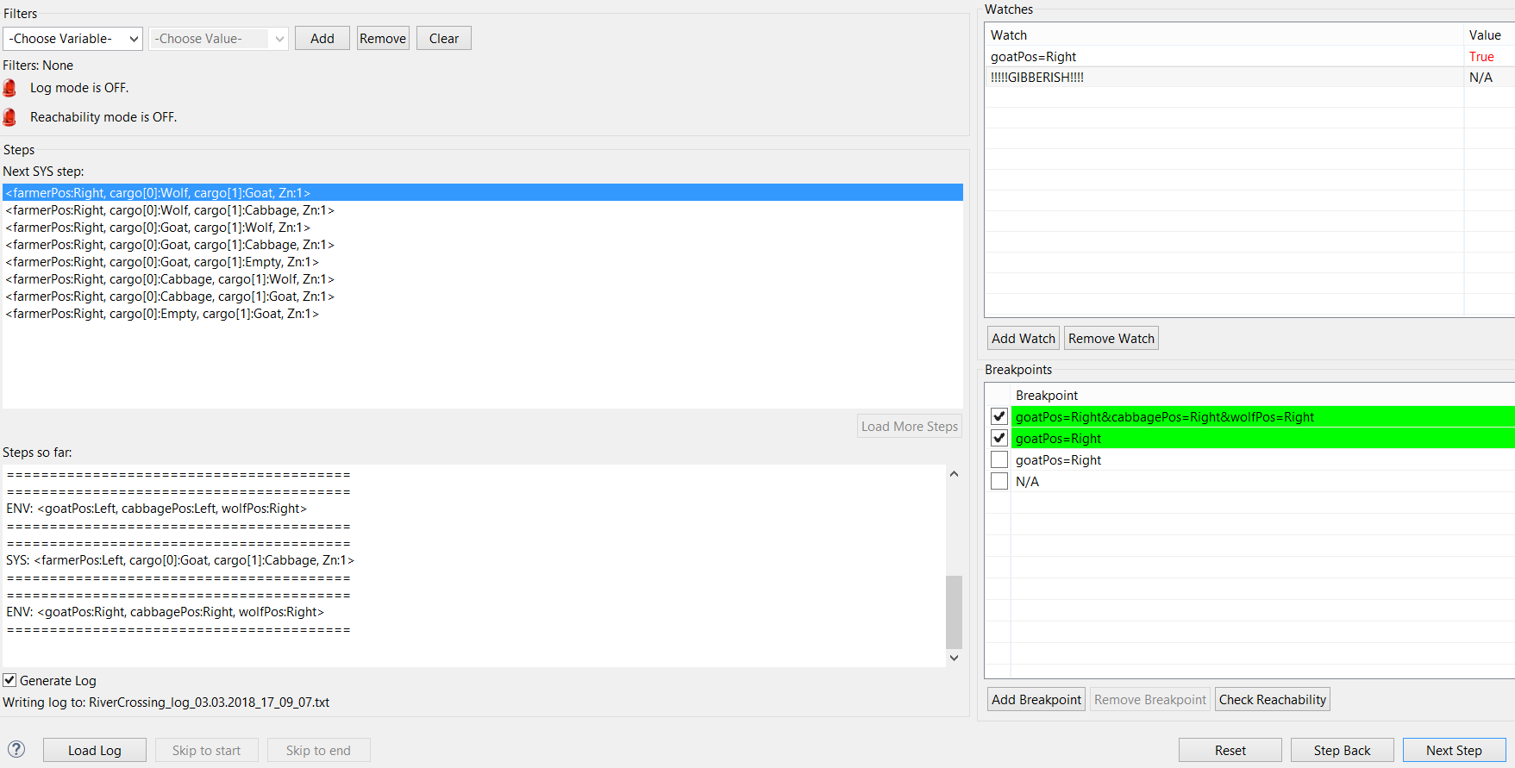
Example: User-defined Predicates as Break-points and Watches
Ido Salomon
Nir Zaidman
Daniel K. Azoulay
Sagi Aharoni
Computer Science Tel Aviv University
Value changed
Valid expression
Invalid expression
Break-points satisfied
Invalid expression
Watch and enabled break-points evaluate correctly. Disabled break-point wasn’t evaluated

Slide 21
Reachability and Walk to User-defined Predicate
Ido Salomon
Nir Zaidman
Daniel K. Azoulay
Sagi Aharoni
Computer Science Tel Aviv University
Engineers can play the reachability game to any break-point. Upon success, the user can choose to ‘Reachability Walk’ on the calculated steps to the break-point (highlighted in yellow).
Similarly to ‘Log Walk’ mode, while in ‘Reachability Walk’, users will traverse states on route until reaching the break-point or actively pushing a button.
In ‘Log Walk’, reachability is played exclusively on logged states.
Upon exiting the mode, the users will be presented with all possible steps from the current state.
Users can skip to end of route via designated button.
‘Reachability Walk’ mode is indicated by a red/green indicator.

Slide 22
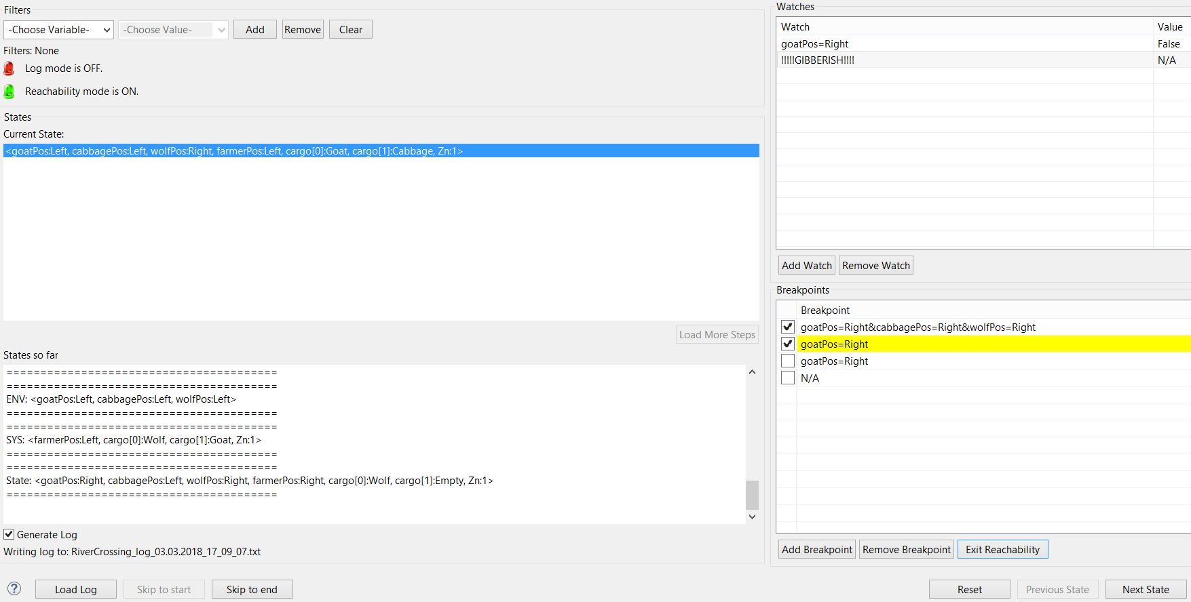
Example: Reachability and Walk to User-defined Predicate
Ido Salomon
Nir Zaidman
Daniel K. Azoulay
Sagi Aharoni
Computer Science Tel Aviv University
Indicator ON
Break-point isn’t satisfied at this state
Target break-point highlighted in yellow
Skip to end of route (break-point satisfied)
Exit reachability mode

Slide 23
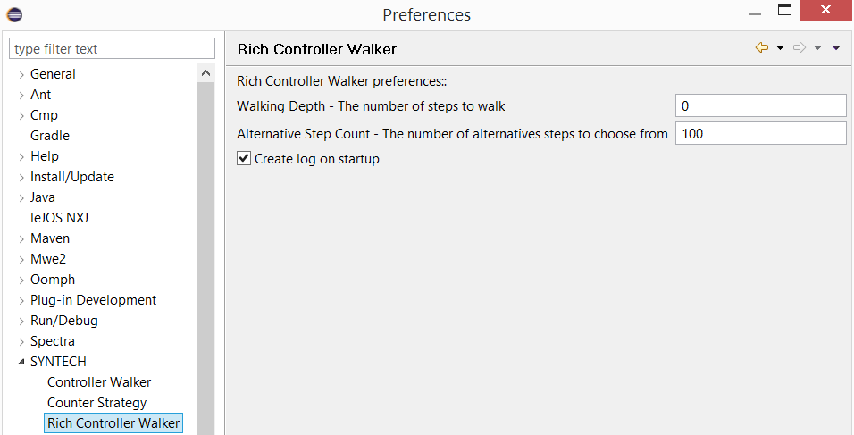
Persistence (User Preferences)
Ido Salomon
Nir Zaidman
Daniel K. Azoulay
Sagi Aharoni
Computer Science Tel Aviv University

Slide 24
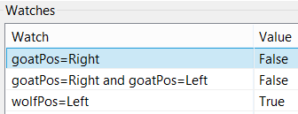
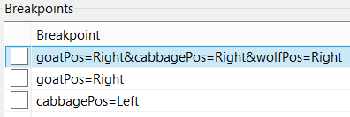
Persistence (Specification Properties)
Ido Salomon
Nir Zaidman
Daniel K. Azoulay
Sagi Aharoni
Computer Science Tel Aviv University
User-defined predicates are saved as resources per Spectra specification. These are translated to watches and break-points at RCW start-up.

Slide 25
Validation and Evaluation
Ido Salomon
Nir Zaidman
Daniel K. Azoulay
Sagi Aharoni
Computer Science Tel Aviv University
Proving correctness of the RCW was challenging, as it is a GUI-centric application.
As such, we manually tested the RCW extensively on many specifications from the repository (SYNTECH17, SYNTECH15, tutorials and others).
Aside from manual testing, we composed a variety of unit-tests to validate the correctness of our logic and utility of major features.

Slide 26
Validation and Evaluation
Ido Salomon
Nir Zaidman
Daniel K. Azoulay
Sagi Aharoni
Computer Science Tel Aviv University
Unit Tests
Basic –
createRichContTest - Test creation of Rich Symbolic Walker using different specs.
doStepsTest - Test that steps are done without errors (on different specs).
Log generation –
logNoOfLinesTest – Tests that logger saves 500 + 1 states for 1000 steps made.

Slide 27
Validation and Evaluation
Ido Salomon
Nir Zaidman
Daniel K. Azoulay
Sagi Aharoni
Computer Science Tel Aviv University
Load and walk on log -
validateMatchStatesAfterLoadLog – Tests that the steps available after 1,000 steps are identical to the steps available after reaching the end of the log that was generated from that walk.
Back-tracking on walk –
stepBackCorrectness – Test that back-tracking restores previous states correctly.
Break-points and watches –
createBpOrWatchTest - Tests creation of new watch\breakpoints using predicate expressions corresponding to spec file. Also validates that bad expressions do not return a BDD.

Slide 28
Validation and Evaluation
Ido Salomon
Nir Zaidman
Daniel K. Azoulay
Sagi Aharoni
Computer Science Tel Aviv University
Reachability -
testReachabilityRoute - Tests that reachability finds a route to a valid state (break-point).
testReachabilityNoRoute - Tests that reachability doesn't find a route to an invalid state.
testReachabilityNoRouteOnLog - Tests that reachability doesn't find a route to an invalid state in ‘Log Walk’.
testReachabilityRouteOnLog - Tests that reachability finds a route to a valid logged state in ‘Log Walk’.

Slide 29
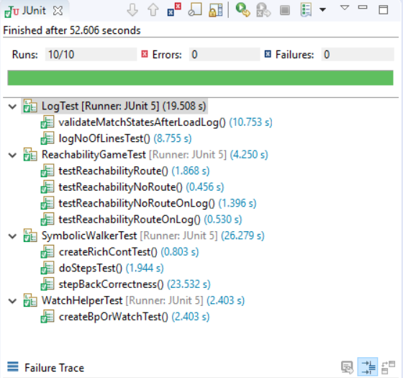
Validation and Evaluation
Ido Salomon
Nir Zaidman
Daniel K. Azoulay
Sagi Aharoni
Computer Science Tel Aviv University

Slide 30
Validation and Evaluation
Ido Salomon
Nir Zaidman
Daniel K. Azoulay
Sagi Aharoni
Computer Science Tel Aviv University
Overall, after experimenting on many specifications, we find that the RCW is a powerful tool that allows the engineer to freely explore the synthesized controller, while offering vital insight that was not available in the original Controller Walker.
Our implementation performed well under heavy loads (exploring complex specifications).
We believe the RCW will encourage development of more robust and correct specifications in SPECTRA.

